Slide 1
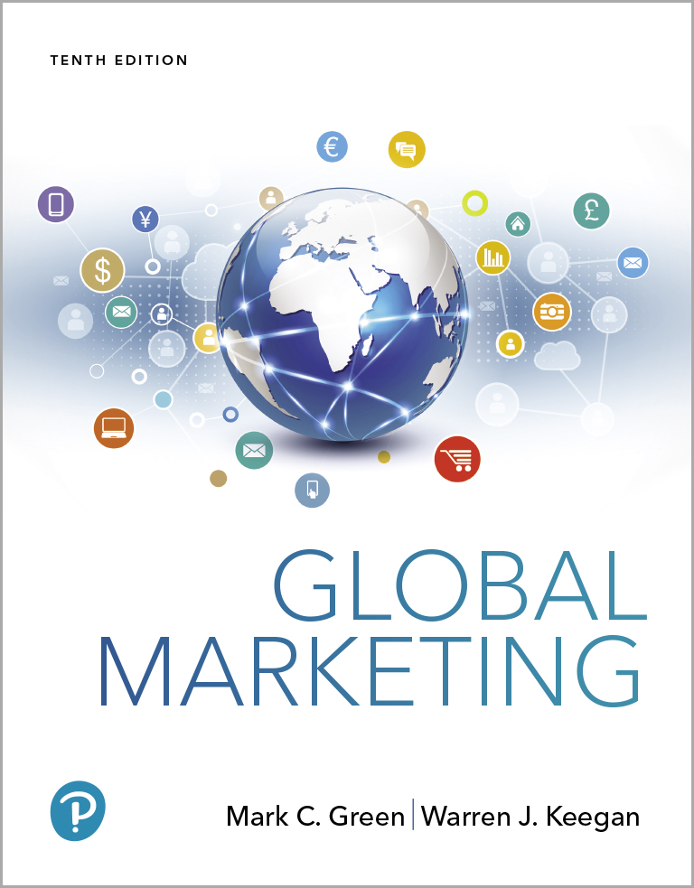
Global Marketing
Tenth Edition
Chapter 7
Segmentation, Targeting, and Positioning
Copyright © 2020, 2017, 2015 Pearson Education, Inc. All Rights Reserved
Notes:
If this PowerPoint presentation contains mathematical equations, you may need to check that your computer has the following installed:
1) MathType Plugin
2) Math Player (free versions available)
3) NVDA Reader (free versions available)

Slide 2
Learning Objectives
7.1 Identify the variables that global marketers can use to segment global markets and give an example of each.
7.2 Explain the criteria that global marketers use to choose specific markets to target.
7.3 Understand how global marketers use a product-market grid to make targeting decisions.
7.4 Compare and contrast the three main target market strategy options.
7.5 Describe the various positioning options available to global marketers.

Slide 3
Global Market Segmentation (1 of 2)
The process of dividing the world market into distinct subsets of customers that have similar needs (for example, country groups or individual interest groups).
Pluralization of Consumption or segment simultaneity theory was advanced by Professor Theodore Levitt four decades ago stating that consumers seek variety and new segments will appear in many national markets. e.g., sushi, pizza
Notes:
Global market segmentation is based on the premise that companies should attempt to identify consumers in different countries who share similar needs and desires. Of course, the fact that significant numbers of pizza-loving consumers are found in many countries does not mean that they are eating the exact same thing. In France, for example, Domino’s serves pizza with goat cheese and strips of pork fat known as lardoons. In Taiwan, toppings include squid, crab, shrimp, and pineapple; Brazilians can order their pies with mashed bananas and cinnamon. As Patrick Doyle, executive vice president of Domino’s international division, explains, “Pizza is beautifully adaptable to consumer needs around the world, simply by changing the toppings.”

Slide 4
Global Market Segmentation (2 of 2)
Types of segmentation methods
Demographic segmentation
Psychographic segmentation
Behavior segmentation
Benefit segmentation

Slide 5
Demographic Segmentation (1 of 2)
Based on measurable population characteristics
Age
Income
Gender
Age distribution
Education
Occupation
Generally, national income is the most important variable
Notes:
Demographic segmentation is based on measurable characteristics of populations, such as income, population, age distribution, gender, education, and occupation. A number of global demographic trends—fewer married couples, smaller family size, changing roles of women, higher incomes and living standards, for example—have contributed to the emergence of global market segments.

Slide 6
Demographic Segmentation (2 of 2)
600 million S E Asian consumers, 70% under age 40
India has the youngest demographic profile among the world’s large nations; 2/3 are younger than 35
Half of Japanese will be 50+ years. by 2025
E U consumers under 16 almost as large as over 60
20% of Americans (70 million) will be 65+ by 2030
U.S. ethnic groups-African/Black, Hispanics, & Asian Americans have a combined annual buying power of $3.5 trillion
U S is home to 28.4 million foreign-born with income of $233b
Notes:
Statistics such as these can provide valuable insights to marketers who are scanning the globe for opportunities. As noted in Chapter 4, for example, Disney hopes to capitalize on the huge number of young people—and their parents’ rising incomes—in India as a means to extend its brand. Managers at global companies must be alert to the possibility that marketing strategies will have to be adjusted in response to the aging of the population and other demographic trends. For example, consumer products companies will need to convene focus groups consisting of people age 50 years or older who are nearing retirement. These same companies will also have to target Brazil, Mexico, Vietnam, and other developing-country markets to achieve their growth objectives in the years to come.

Slide 7
Income & Population Segmentation
2/3 world G N I in the Triad, 12% of population
Don’t use income as the only variable for assessing market opportunity
Use Purchasing Power Parity
Do not read into the numbers
Some services are free in developing nations so there is more purchasing power
For products with low enough price, population is a more important variable
Notes:
Ideally, gross domestic product (GDP) and other measures of national income converted to U.S. dollars should be calculated on the basis of purchasing power parities (i.e., what the currency will buy in the country of issue) or through direct comparisons of actual prices for a given product. This would provide an actual comparison of the standards of living in the countries of the world.
Ideally, gross domestic product (GDP) and other measures of national income converted to U.S. dollars should be calculated on the basis of purchasing power parities (PPP; i.e., what the currency will buy in the country of issue) or through direct comparisons of actual prices for a given product. This approach provides an actual comparison of the standards of living in the countries of the world.

Slide 8
Purchasing Power Parity
G D P converted to U.S. currency should be calculated by P P P
P P P is what the currency will buy in the country of issue
Industrialized countries paid for goods and services that are free in poor countries
Chinese per capita income $8,250; P P P adjusts to $15,500
10 most populous countries have 60% of world income
5 most populous countries have 46% of that

Slide 9
China and India, World’s Largest Countries
1.3 billion population each
High income, fast growing high-income segments in both
C P G companies are targeting India where the middle class of 300 million but not all own cars, computers, washing machines
Mass marketing is problematic due to regional differences of language, culture, history

Slide 10

Market Segments by Income & Population
Global Teens-12 and 19 year. olds
“A group of teenagers randomly chosen from different parts of the world will share many of the same tastes.”
Global Elite-affluent consumers who are well traveled and have the money to spend on prestigious products with an image of exclusivity
Notes:
Young consumers may not yet have conformed to cultural norms; indeed, they may be rebelling against them. This fact, combined with shared universal wants, needs, desires, and fantasies (for name-brand, novelty, entertainment, trendy, and image-oriented products), makes it possible to reach the global teen segment with a unified marketing program.
This segment is attractive both in terms of its size (approximately 1.3 billion people) and its multi-billion-dollar purchasing power. According to London-based trend consultancy LS:NGlobal, the U.S. teen market represents roughly $200 billion in annual buying power; the United Kingdom’s 7.5 million teens spend more than $10 billion each year. Coca-Cola, Benetton, Swatch, and Sony are some of the companies pursuing the global teen segment. The global telecommunications revolution is a critical driving force behind the emergence of this segment. Global media such as MTV, Facebook, and Twitter are perfect vehicles for reaching this segment. Meanwhile, satellites are beaming Western programming and commercials to millions of viewers in China, India, and other emerging markets.
Another global segment is the global elite, affluent consumers who are well traveled and have the money to spend on prestigious products with an image of exclusivity (see Exhibit 7-4). Although this segment is often associated with older individuals who have accumulated wealth over the course of a long career, it also includes movie stars, musicians, elite athletes, entrepreneurs, and others who have achieved great financial success at a relatively young age. China is home to 18,000 such individuals, which means it ranks number 2 overall worldwide. This segment of the Chinese population is expected to grow 40 percent in the next 5 years.

Slide 11
Gender Segmentation
Gender segmentation is an obvious choice for some companies
Fashion designers & cosmetic companies focus on women but may also offer men’s products
Nike is focused on women
Levi Strauss opened Levi’s for Girls in Paris
Notes:
In 2015, Nike generated $5.7 billion in global sales of women’s shoes and apparel. Nike executives believe the company’s global women’s business is poised for big growth, with sales expected to increase to $11 billion by 2020. The recent growth in this segment is due in large part to women’s increased interest in fitness and the athleisure trend. Nike’s recent advertising campaign, keyed to the theme #betterforit, encouraged women to share their fitness goals on social media.
If Levi’s for Girls succeeds in France, similar stores will be opened in other European countries.

Slide 12
Psychographic Segmentation
Based on attitudes, values, and lifestyle
Lifestyle surveys
S R I International’s Values and Life Styles, V A L S & V A L S 2
Porsche example
Top Guns (27%): Ambition, power, control
Elitists (24%): Old money, car is just a car
Proud Patrons (23%): Car is reward for hard work
Bon Vivants (17%): Car is for excitement, adventure
Fantasists (9%): Car is form of escape

Slide 13
Big Data and Data Mining
Facebook & other tech firms mine social media
Analytics include qualitative and quantiative techniques
Retailers embed F B‘s pixel code in their Web sites
F B Consumer Insight‘s categories: Shopping Mavens, Fashion Enthusiasts, Opportunistic Shoppers, etc.

Slide 14
Behavior Segmentation
Focus on whether people purchase a product or not, how much, and how often they use it
Usage rates: heavy, medium, light, non-user
User status: potential, non-users, ex-users, regulars, first-timers, users of competitor’s products
80/20 Rule or Law of Disproportionality or Pareto’s Law-80% of a company’s revenues are accounted for by 20% of the customers
Notes:
Behavior segmentation focuses on whether or not people buy and use a product, as well as how often, and how much they use or consume. Consumers can be categorized in terms of usage rates: for example, heavy, medium, light, and non-user. Consumers can also be segmented according to user status: potential users, non-users, ex-users, regulars, first-timers, and users of competitors’ products. Nine country markets generate about 80 percent of McDonald’s revenues.
And, as you learned in Case 6-1 about the music business, 5 percent of recording artists account for 95 percent of all artist-related Facebook engagement. So, one challenge facing an emerging or “undiscovered” artist seeking to build his or her career in the music industry is how to increase audience size on Facebook, Twitter, and other online platforms—maybe drop a new single every month to generate online buzz?

Slide 15
Benefit Segmentation
Benefit segmentation focuses on the value equation
,
Based on understanding the problem a product solves, the benefit it offers, or the issue it addresses
Notes:
Benefit segmentation focuses on the numerator of the value equation—the B in V = B/P. This approach is based on marketers’ superior understanding of the problem a product solves, the benefit it offers, or the issue it addresses, regardless of geography. Food marketers are finding success creating products that can help parents create nutritious family meals with a minimal investment of time. Campbell Soup is making significant inroads into Japan’s $500 million soup market as time-pressed homemakers place a premium on convenience. Marketers of health and beauty aids also use benefit segmentation. Many toothpaste brands are straightforward cavity fighters, and as such they reach a very broad market. However, as consumers become more concerned about whitening, sensitive teeth, gum disease, and other oral care issues, marketers are developing new toothpaste brand extensions suited to the different sets of perceived needs.

Slide 16
Ethnic Segmentation
The population of many countries includes ethnic groups of significant size
Three main groups in the U.S. are African-Americans, Asian-Americans, and Hispanic Americans
Subdivide Asians further: Thai, Vietnamese, & Chinese Americans
Hispanic Americans
55 million Hispanic Americans (17% of total pop.) with $2 trillion annual buying power
“$1 trillion Latina” 24 million Hispanic women: 42% single, 35% H O H, 54% working
Notes:
In many countries, the population includes ethnic groups of significant size. In the United States, for example, the three major ethnic segments are African/Black Americans, Asian Americans, and Hispanic Americans. Each segment shows great diversity and can be further subdivided. For example, Asian Americans include Thai Americans, Vietnamese Americans, and Chinese Americans, and each of these groups speaks a different language.
From a marketing point of view, the various Hispanic American segments represent a great opportunity. Companies in a variety of industry sectors, including food and beverages, consumer durables, and leisure and financial services, are recognizing the need to include these segments when preparing marketing programs for the United States. Almost two decades ago, companies based in Mexico began zeroing in on opportunities to the north. Three Mexican retailers—Famsa, Grupo Gigant SA, and Grupo Comercial Chedraui SA—all opened stores in the United States. As Famsa President Humberto Garza Valdez explained at the grand opening of a store in San Fernando, California, “We’re not coming to the U.S. to face big companies like Circuit City or Best Buy. Our focus is the Hispanic market.”

Slide 17
Assessing Market Potential (1 of 2)
Be mindful of the pitfalls
Tendency to overstate the size and short-term attractiveness of individual country markets
The company does not want to ‘miss out’ on a strategic opportunity
Management’s network of contacts will emerge as a primary criterion for targeting
Notes:
After segmenting the market by one or more of the criteria just discussed, the next step is to assess the attractiveness of the identified segments. This part of the process is especially important when sizing up emerging country markets as potential targets. It is at this stage that global marketers should be mindful of several potential pitfalls associated with the market segmentation process.

Slide 18
Assessing Market Potential (2 of 2)
Current size of the segment and growth potential
Single market segment may be small but if in several countries may hold potential
Potential competition
May avoid markets with strong competition unless vulnerable because of price or quality
Notes:
Market Size: As noted earlier, one of the advantages of targeting a market segment globally is that although the segment in a single-country market might be small, even a narrow segment can be served profitably if that same segment exists in several countries. The billion-plus members of the global MTV Generation are a case in point. Moreover, by virtue of its size and purchasing power, the global teen segment is extremely attractive to consumer goods companies. In the case of a huge country market such as India or China, segment size and growth potential may be assessed in a different manner.
From the perspective of a consumer packaged goods company, for example, low incomes and the absence of a distribution infrastructure offset the fact that 75 percent of India’s population lives in rural areas. The appropriate decision may be to target urban areas only, even though they are home to only 25 percent of the population.
Competition
A market segment or country market characterized by strong competition may be a segment to avoid. However, if the competition is vulnerable in terms of price or quality disadvantages, it is possible for a market newcomer to make significant inroads. Over the past several decades, for example, Japanese companies in a variety of industries have targeted the U.S. market despite the presence of entrenched domestic market leaders. Some of the newcomers proved to be extremely adept at segmenting and targeting; as a result, they made significant inroads. In the motorcycle industry, for example, Honda first created the market for small-displacement dirt bikes. The company then moved upmarket with bigger bikes targeted at casual riders whose psychographic profiles were quite different from those of the hard-core Harley-Davidson rider.

Slide 19
Feasibility and Compatibility (1 of 2)
Negative Factors
Regulatory factors
Marketing issues like distribution
Adaptation?
Import restrictions, high tariffs, strong home-country currency
Sourcing? Local or import?
Segment compatible with the brand, goals, competitive advantage source?

Slide 20
Feasibility and Compatibility (2 of 2)
Will adaptation be required? If so, is this economically justifiable in terms of expected sales?
Will import restrictions, high tariffs, or a strong home country currency drive up the price of the product in the target market currency and effectively dampen demand?
Notes:
If a market segment is judged to be large enough, and if strong competitors are either absent or deemed to be vulnerable, then the final consideration is whether a company can and should target that market. The feasibility of targeting a particular segment can be negatively impacted by various factors. For example, significant regulatory hurdles may be present that limit market access. This issue is especially important in China today. Other marketing-specific issues can arise; in India, for example, three to five years are required to build an effective distribution system for many consumer products. This fact may serve as a deterrent to foreign companies that might otherwise be attracted by the apparent potential of India’s large population.

Slide 21
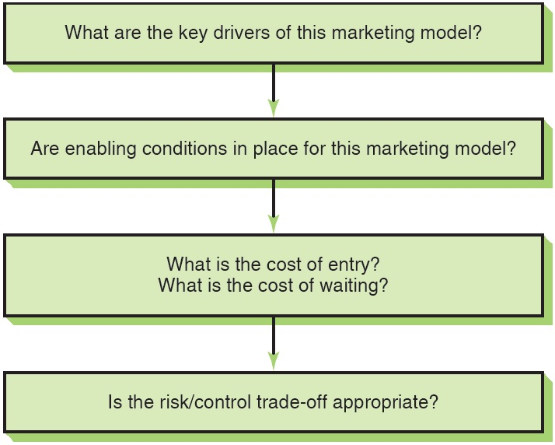
Framework for Selecting Target Markets
Figure 7-1 Screening Criteria for Market Segments
Notes:
Global marketing expert David Arnold has developed a framework that goes beyond demographic data and considers other, marketing-oriented assessments of market size and growth potential. Instead of a “top-down” segmentation analysis beginning with, say, income or population data from a particular country, Arnold’s framework is based on a “bottom-up” analysis that begins at the product-market level. After marketing-model drivers and enabling conditions have been identified, the third step is for management to weigh the estimated costs associated with entering and serving the market with potential short- and long-term revenue streams. Does this segment or country market merit entry now? Or, would it be better to wait until, say, specific enabling conditions are established?
Marketing model drivers are key elements or factors required for a business to take root and grow in a particular country market environment. The drivers may differ depending on whether a company serves consumer or industrial markets. Does success hinge on establishing or leveraging a brand name? Or, is distribution or a tech-savvy sales staff the key element? Marketing executives seeking an opportunity must arrive at insights into the true driving force(s) that will affect success for their particular product market.
Enabling conditions are structural market characteristics whose presence or absence can determine whether the marketing model can succeed. For example, in India, refrigeration is not widely available in shops and market food stalls. This creates challenges for Nestlé and Cadbury Schweppes as they attempt to capitalize on Indians’ increasing appetite for chocolate confections. Although Nestlé’s KitKat and Cadbury’s Dairy Milk bars have been reformulated to better withstand heat, the absence or rudimentary nature of refrigeration hampers the companies’ efforts to ensure their products are in saleable condition.
After marketing model drivers and enabling conditions have been identified, the third step is for management to weigh the estimated costs associated with entering and serving the market with potential short- and long-term revenue streams. Does this segment or country market merit entry now? Or, would it be better to wait until specific enabling conditions are established? The issue of timing is often framed in terms of the quest for first-mover advantage. The conventional wisdom is that the first company to enter a market has the best chance of becoming the market leader.

Slide 22
9 Questions for Creating a Product-Market Profile (1 of 2)
Who buys our product?
Who does not buy it?
What need or function does it serve?
Is there a market need that is not being met by current product/brand offerings?
What problem does our product solve?

Slide 23
9 Questions for Creating a Product-Market Profile (2 of 2)
What are customers buying to satisfy the need for which our product is targeted?
What price are they paying?
When is the product purchased?
Where is it purchased?

Slide 24
Product-Market Decisions
Review current and potential products for best match for country markets or segments
Create a matrix with countries and products to help with analysis
Table 7-7, the 2012 Product-Market Grid for Lexus, shows which models are available in selected country markets
The I S model is available in all countries but the H S is only in North America

Slide 25
Target Market Strategy Options (1 of 2)
Standardized Global Marketing or Undifferentiated target marketing
Mass marketing on a global scale
Standardized marketing mix
Minimal product adaptation
Intensive distribution
Lower production costs
Lower communication costs

Slide 26
Target Market Strategy Options (2 of 2)
Concentrated Global Marketing
Niche marketing
Single segment of global market
Look for global depth rather than national breadth
Ex.: Chanel, Estee Lauder
Differentiated Global Marketing
Multisegment targeting
Two or more distinct markets
Wider market coverage
Ex.: P&G markets Old Spice and Hugo Boss for Men
Notes:
Concentrated: A niche is simply a single segment of the global market. In cosmetics, Estee Lauder, Chanel, and other cosmetics marketers have used this approach successfully to target the upscale, prestige segment of the market. Germany’s Winterhalter makes dishwashers for the restaurant industry only.
Differentiated: Danone SA, the French foods company, targets consumers in developed countries with premium brands like Evian, Badoit mineral waters, and Dannon and Activia yogurts.
In the cosmetics industry, Unilever NV and Cosmair Inc. pursue differentiated global marketing strategies by targeting both ends of the perfume market. Unilever targets the luxury market with Calvin Klein and Elizabeth Taylor’s Passion; Wind Song and Brut are its mass-market brands. Cosmair sells Tresnor and Giorgio Armani Gio to the upper end of the market and Gloria Vanderbilt to the lower end. Mass marketer Procter & Gamble, known for its Old Spice and Incognito brands, also embarked upon this strategy with its 1991 acquisition of Revlon’s EuroCos, marketer of Hugo Boss for men and Laura Biagiotti’s Roma perfume. In the mid-1990s, P&G launched a new prestige fragrance, Venezia, in the United States and several European countries. . Currently, Procter & Gamble also markets Envy, Rush, and other Gucci fragrances as a licensee of the Italian fashion house.

Slide 27
Positioning (1 of 3)
Locating a brand in consumers’ minds over and against competitors in terms of attributes and benefits that the brand does and does not offer
Attribute or Benefit
Quality and Price
Use or User
Competition
Notes:
The term positioning is attributed to marketing gurus Al Ries and Jack Trout, who first introduced it in a 1969 article published in Industrial Marketing magazine. As noted at the beginning of the chapter, positioning refers to the act of differentiating a brand in customers’ minds in relation to competitors in terms of attributes and benefits that the brand does and does not offer. Put differently, positioning is the process of developing strategies for “staking out turf” or “filling a slot” in the mind of target customers.
Positioning is frequently used in conjunction with the segmentation variables and targeting strategies discussed previously. For example, Unilever and other consumer goods companies often engage in differentiated target marketing, offering a full range of brands within a given product category. Unilever’s various detergent brands include All, Wisk, Surf, and Persil; each is positioned slightly differently. In some instances, extensions of a popular brand can also be positioned in different ways. Colgate’s Total toothpaste is positioned as the brand that addresses a full range of oral health issues, including gum disease. In most parts of the world, Total is available in several formulations, including Total Advanced Clean, Total Clean Mint Paste, and Total Whitening Paste. Effective positioning differentiates each variety from the others.
In the decades since Ries and Trout first focused attention on the importance of the concept, marketers have utilized a number of general positioning strategies. These include positioning by attribute or benefit, quality and price, use or user, or competitor. Recent research has identified three additional positioning strategies that are particularly useful in global marketing: global consumer culture positioning, local consumer culture positioning, and foreign consumer culture positioning.

Slide 28
Positioning (2 of 3)
Attribute or Benefit
Economy
Reliability
Durability
B M W: The Ultimate Driving Machine or
Visa: It’s Everywhere You Want To Be
Quality and Price
Continuum from high price/quality and high price to good value
Stella Artois beer: Reassuringly Expensive

Slide 29
Positioning (3 of 3)
Use or User
Associates the brand with a user or class of users
Max Factor: The makeup that makeup artists use
Competition
Implicit or explicit reference to competition
Dove: Campaign for Real Beauty
2% of women worldwide think they are beautiful
New definition of beauty

Slide 30
Positioning Strategies
Global consumer culture positioning
Identifies the brand as a symbol of a particular global culture or segment
High-touch and high-tech products
Foreign consumer culture positioning
Associates the brand’s users, use occasions, or product origins with a foreign country or culture
Local consumer culture positioning
Identifies with local cultural meanings
Consumed by local people
Locally produced for local people
Used frequently for food, personal, and household nondurables
Ex.: Budweiser is identified with small-town America
Notes:
Global consumer culture positioning:
“United Colors of Benetton” means the unity of humankind.
My First Sony: for kids with discerning parents
High-tech: MP3 players, cell phones, luxury cars, financial services, Canon cameras, Adidas
High-touch: luxury perfume, high fashion, Nescafe coffee
A brand’s GCCP can be reinforced by the careful selection of the thematic, verbal, or visual components that are incorporated into advertising and other communications. For marketers seeking to establish a high-touch GCCP, leisure, romance, and materialism are three themes that cross borders well. For high-tech products such as global financial services, professionalism and experience are advertising themes that work well. In the early 1990s, for example, Chase Manhattan bank launched a $75 million global advertising campaign geared to the theme “Profit from experience.” According to Aubrey Hawes, a vice president and corporate director of marketing for the bank, Chase’s business and private banking clients “span the globe and travel the globe. They can only know one Chase in their minds, so why should we try to confuse them?” Presumably, Chase’s target audience is sophisticated enough to appreciate the subtlety of the copywriter’s craft—“profit” can be interpreted as either a noun (“monetary gain”) or a verb (“reap an advantage”). Another way to reinforce a GCCP is to use brand symbols whose interpretation defies association with a specific country culture. Examples include Nestlé’s “little nest” logo with an adult bird feeding its babies, the Nike swoosh, and the Mercedes-Benz star.
Foreign CCP:
Foster’s beer & Australia
Ikea & Sweden

Slide 31

Copyright
This work is protected by United States copyright laws and is provided solely for the use of instructors in teaching their courses and assessing student learning. Dissemination or sale of any part of this work (including on the World Wide Web) will destroy the integrity of the work and is not permitted. The work and materials from it should never be made available to students except by instructors using the accompanying text in their classes. All recipients of this work are expected to abide by these restrictions and to honor the intended pedagogical purposes and the needs of other instructors who rely on these materials.

